Slide 1
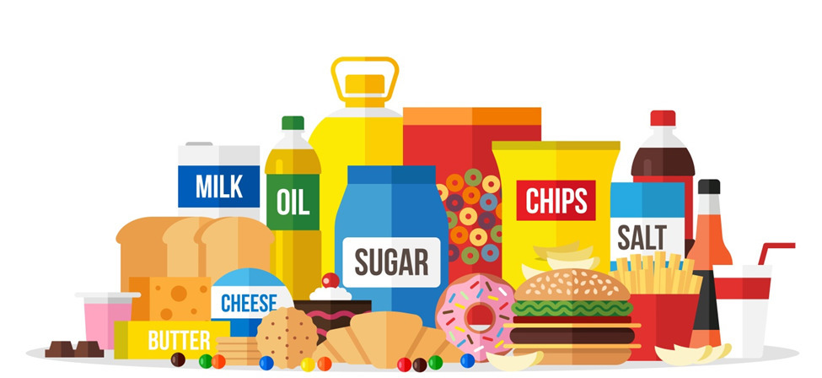
Analysis of Food Manufacturing Company
By Syed Amanullah
IVY Pro School

Slide 2
Project Analysis
Objectives
Charts
Insights
Analysis
Task 1
Task 2
Task 3

Slide 3
The food industry is a complex, global network of diverse businesses that supplies most of the food consumed by the world's population.
The term food industries covers a series of industrial activities directed at the production, distribution, processing, conversion, preparation, preservation, transport, certification and packaging of foodstuffs.
The food industry today has become highly diversified, with manufacturing ranging from small, traditional, family-run activities that are highly labor-intensive, to large, capital-intensive and highly mechanized industrial processes.

Slide 4
Objectives.
Which are the top five bestselling products.
Five least famous products.
Which products are favorite for customers as High fat or regular fat?
Sales at different outlet types.
The most expensive item.
Show the sales of the items where sales are greater than 2500 for low-fat items.
Show the sales for the item type which contains drinks.

Slide 5
Top & least Selling Products

Slide 6
Outlets

Slide 7
Outlets

Slide 8
Insights
The sales of fruits and vegetables are higher.
Seafood is the least selling products.
Customers have purchased more low-fat items as a comparison to any regular fat items.
The most favourite shopping destination is Supermarket Type1 and 60% revenue is generated by fruits and vegetables, snacks, household, frozen food and dairy.
Mostly sales were done at medium size outlet and least at the high size.
Canned is the most expensive product.
Sales for soft drink is the highest as a comparison to the hard drink.

Slide 9
Thank You!

